Slide 1
Internet Explorer is a Wonderful Browser and an Absolute Pleasure to Work With
Josh Goldberg
Microsoft Sway

Slide 2

@JoshuaKGoldberg
Interests:
JavaScript
TypeScript
React
Web apps & performance
Find me on:
GitHub
Medium
Twitter

Slide 3
Context
IE vs Netscape: IE Won
Microsoft stopped doing things with IE
Chrome and Firefox became great; IE did not

Slide 4

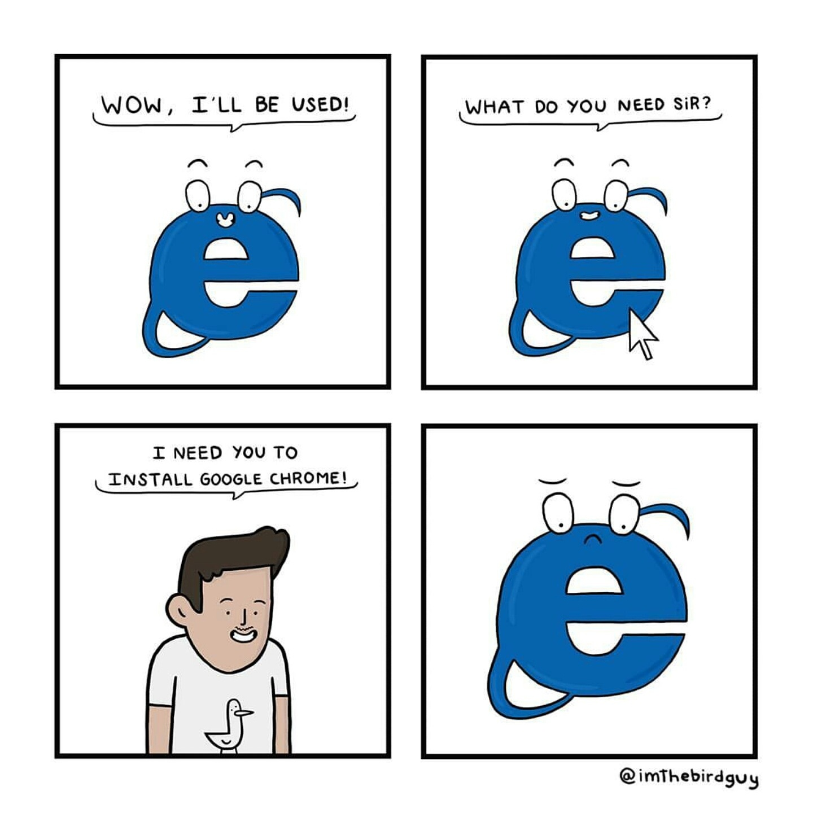


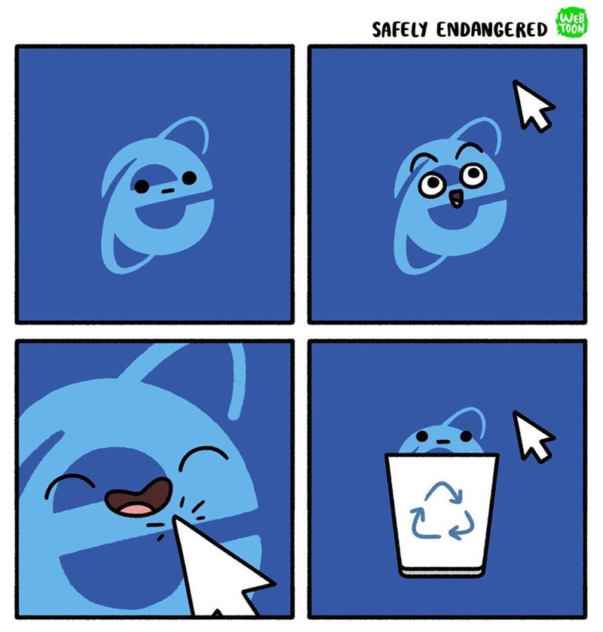
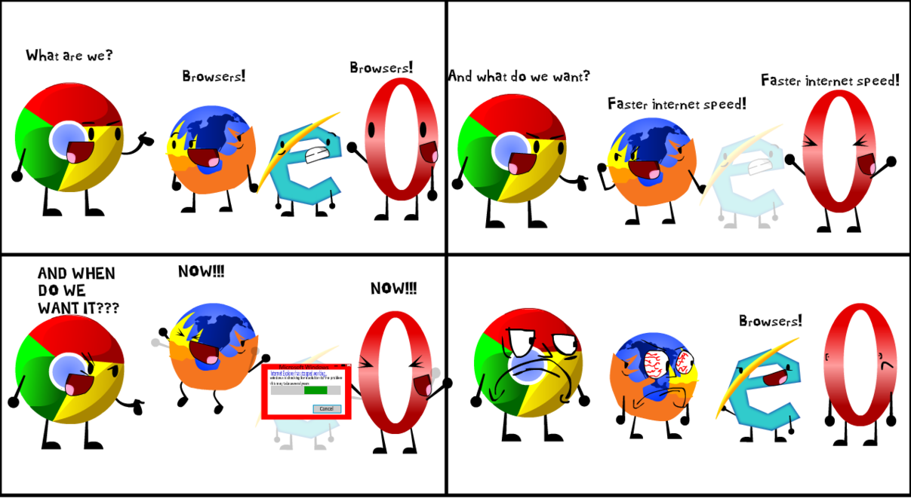

Everybody Hates IE
Media left-to-right, top-to-bottom:
https://shoze.blogspot.com
https://www.instagram.com/imthebirdguy
https://windowsmaster1985.deviantart.com
https://www.safelyendangered.com

Slide 5
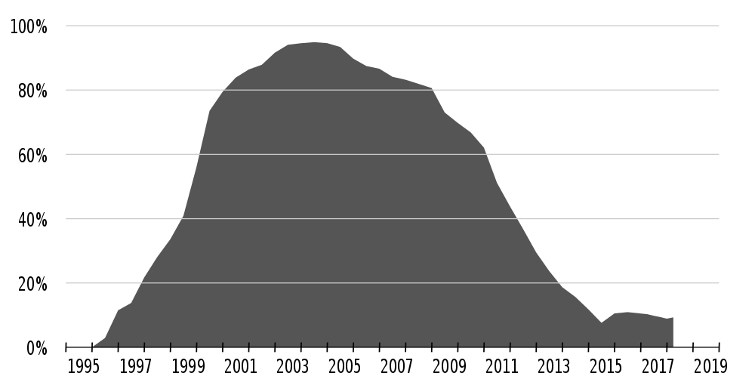

but people still use it
wtf
https://en.wikipedia.org/wiki/Internet_Explorer

Slide 6

Legitimate reasons
Low tech aptitude
Low tech availability
Restricted upgrade cycle
Small businesses
Government
Education
https://giphy.com/gifs/why-ryan-reynolds-1M9fmo1WAFVK0

Slide 7
ugh

Slide 8
Problem: sometimes no stacks
How can you fix what you can’t locate?

Slide 9
window.onerror = function (message, file, line, col, error) {
console.log({ message: message, file: file, line: line, col: col });
};
throw new Error("Test");
Chrome:
message: "Uncaught Error: Test", file: "https://a.com/main.js", line: 5, col: 7
Firefox:
message: "Uncaught Error: Test", file: "https://a.com/main.js", line: 5, col: 7
IE normally:
message: "Uncaught Error: Test", file: "https://a.com/main.js", line: 5, col: 7
IE sometimes:
message: "Uncaught Error: Test", file: "https://a.com/main.js", line: 0, col: 0

Slide 10

window.onerror = function (_m, _f, _l, _c, error) {
console.log(error.stack);
};
function main() {
throw new Error("Test");
}
main();
Chrome:
"Error: Test! at https://a.com/main.js:6:11 at https://a.com/main.js:9:1"
Firefox:
"Error: Test! at https://a.com/main.js:6:11 at https://a.com/main.js:9:1"
IE normally:
"Error: Test! at https://a.com/main.js:6:11 at Global Code https://a.com/main.js:9:1"
IE sometimes:
stack: null
https://knowyourmeme.com/photos/192296-computer-reaction-faces

Slide 11
Solution: try/catch everything
Caught errors always have their stacks

Slide 12
function logAndRethrow(action) {
try {
action();
} catch (error) {
// (read: upload log with stack)
console.log(error.stack);
throw error;
}
}
main();
logAndRethrow(main);
element.onClick = function () {
logAndRethrow(function () { /* ... */ });
};
element.onClick = function () { /* ... */ };

Slide 13
Places to log
Time APIs such as setTimeout and setInterval
Event handlers such as elements’ .onclick
Network request callbacks
Callbacks passed to external libraries that perform any of the above

Slide 14
function safeSetTimeout(callback, delay) {
var args = [].slice.call(arguments, 2);
setTimeout(
function () {
logAndRethrow(function () {
callback.apply(this, args);
});
},
delay
);
}
setTimeout(main, 100);
safeSetTimeout(main, 100);

Slide 15
Tip: linting
We use TSLint, the TypeScript linter, to ban all uses of the native APIs
{
"rules": {
// ...
"ban": [
true,
["setInterval", "Use wrappedSetInterval for IE stacks."],
["setTimeout", "Use wrappedSetTimeout for IE stacks."],
// ...
]
// ...
}
}

Slide 16
Problem: touching globals
“Don’t touch things you don’t own!” – lesson we should have learned in 2008

Slide 17
Code from, like, 8 years ago
Our polyfill:
if (!Array.prototype.includes) {
Array.prototype.includes = function (item) {
return this.indexOf(item) !== -1;
};
}
Spec implementation:
Array.prototype.includes = function (item, from) {
return this.indexOf(item, from) !== -1;
};

Slide 18
Code from, like, 8 years ago
["foo"].includes("foo", 1);
After our improper polyfill:
Result in evergreen browsers: false
Result in IE: true

Slide 19
Solution: stop touching globals

Slide 20
Instead of overriding the prototype:
/**
* @deprecated Use the proper polyfill instead
*/
function legacyArrayIncludes(array, item) {
return array.indexOf(item);
}

Slide 21
Problem: creating globals
“Don’t touch things you don’t own!” – lesson we should have learned last slide

Slide 22
HTML-printed globals
Common practice: set global variables for server-provided values in your HTML
<script>
window.context = {
build: "1.2.3.4"
};
</script>
Problem: browser extensions sometimes override common global names such as context or settings.
Chrome extensions in particular!

Slide 23
Solution: fancy names

Slide 24
Name it something poorly written browser extensions won’t use:
<script>
window.swayAppContextYippee = {
build: "1.2.3.4"
};
</script>

Slide 25
Problem: IE sucks
…at doing things?

Slide 26
Each line sometimes throws in IE
var activeElement = document.activeElement;
// (assuming it's an <input>)
var value = activeElement.value;
activeElement.click();

Slide 27
Solution?

Slide 28
Solution?
Try again?
function getDocumentActiveElement() {
try {
return document.activeElement;
} catch {
return document.activeElement;
}
}
STILL SOMETIMES THROWS LOL

Slide 29
Solution?

Slide 30
Solution?
Try 9001 times?
function getDocumentActiveElement() {
for (var i = 0; i < 9001; i += 1) {
try {
return document.activeElement;
} catch { }
}
}
STILL SOMETIMES THROWS LOL

Slide 31
Solution?

Slide 32
Solution?
🤷‍♂️

Slide 34
Problem: race conditions

Slide 35
Race conditions
IE does things a little differently
Old spaghetti code initialization phases are particularly susceptible to browser-specific race conditions and weird states
1 in 10,000 initializations fails
Do we even care at this point?
How do you flush them out?

Slide 36
Solution: stress testing

Slide 37
Stress testing
Make a page with a dozen <iframe>s pointing to your website and reload them once a second
function reloadIframes() {
for (var i = 0; i < iframes.length; i += 1) {
iframes[i].contentWindow.location.reload();
}
setTimeout(reloadIframes, 100);
}
reloadIframes();

Slide 38
Stress testing
…and if that doesn’t work?

Slide 39
Solution: overly verbose logging

Slide 40
Overly verbose logging
Send logs all up in your spaghetti code that only log on IE
function logIfIE() {
if (browserIsIE()) {
log("IE-secific log:", arguments);
}
}

Slide 41
Overly verbose logging
…and if that doesn’t work?

